Slide 1
An examination of bird sighting data for the Netherlands
Notes:
I thought about some other topics initially that I had much more domain knowledge of but I chose this project in order to try something a little different and take me outside my comfort zone as I have little domain knowledge about birds other than what I have learned over the years. I thought it would present an opportunity to learn something new and test some of what we have learned here in the bootcamp.

Slide 2
I explored the following 5 questions.
1 | What birds are the most frequently sighted in The Netherlands, what can we see if we look at sightings by days of the week?
2 | Which provinces in The Netherlands have more sightings and does the time of year have any significance (seasonality)?
3 | Investigate the number of observations for the following types of the observation protocols (what the observer was doing): Stationary, Travelling, Historical and Incidental. What do we learn?
4 | Determine if there is a statistical dependency between birds observed and protocol type (the way they were observed). Which statistical test should we use and why?
5 | Is the population of a Dutch province (area) a significant predictor of no. of sightings?

Slide 3

Dealing with the data
The initial complete dataset of 140GB was gigantic
This was eventually reduced to a more reasonable 60MB
50 Columns
1.8M rows of data
Reduced to 31 columns and 10K rows
Date column was ‘object’ so was changed to datetime format
Notes:
The dataset I acquired was initially 140GB, I could see Python starting to sweat at this point so the sample needed to be smaller. I chose to narrow the scope of the project to covering the Netherlands from 2018 to 2023 which still gave 60MB of data and 1.8M rows. I decided on using a sample of 10000 rows from the data set. At first I did not realise I was reading only the first 10K rows which would mean an extremely biased set would have been examined. I solved this by defining a function (FOR LOOP - thanks Marina) to randomly sample 10K and used a seed in order to preserve the consistency of the random sample.

Slide 4
Question 1 : What birds are the most frequently sighted in The Netherlands, what can we see if we look at sightings by days of the week?

Slide 5
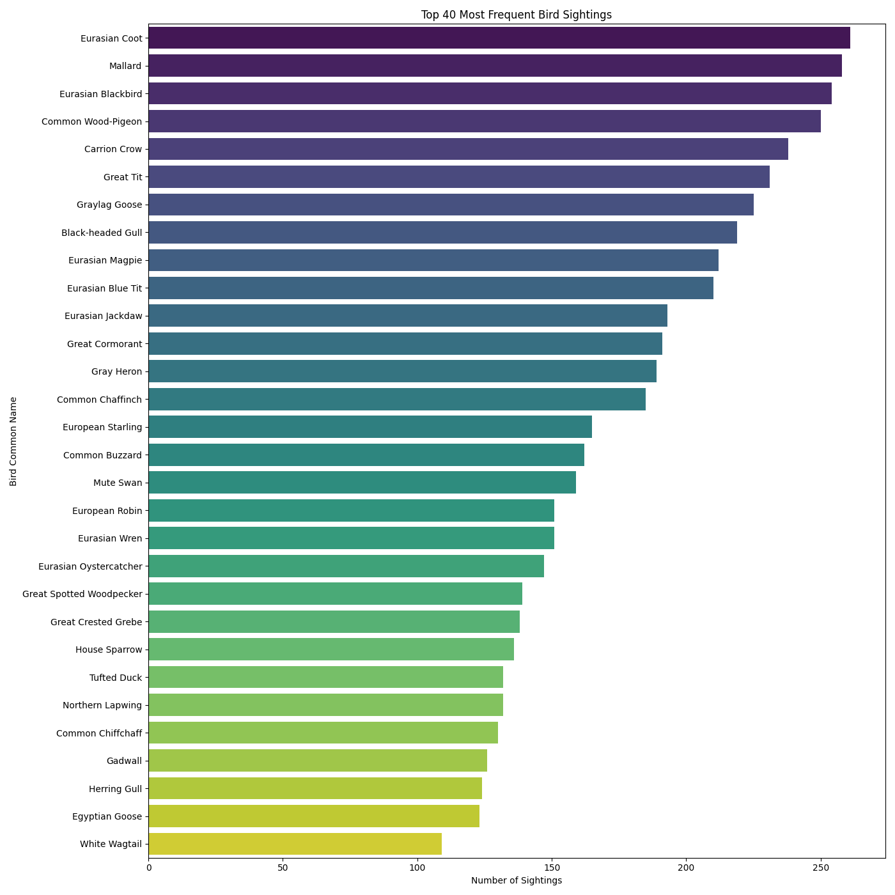
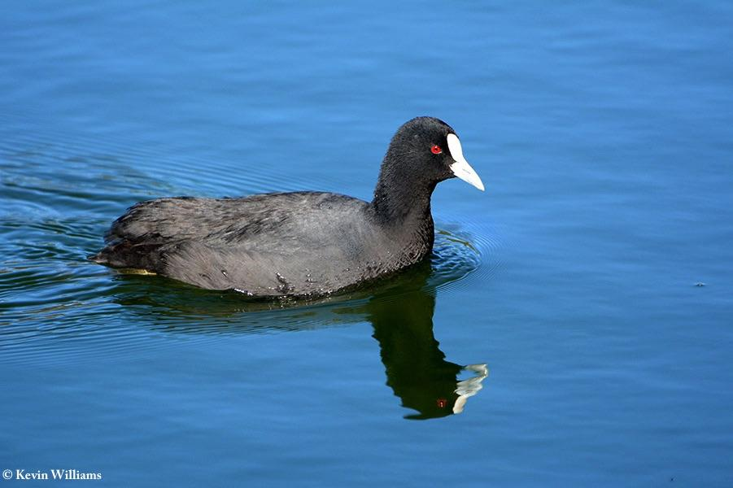
271 unique birds (by common name) are present in the sightings data sample. These are the top 30 birds by the number of sightings
The most sighted bird in the The Netherlands: The Eurasian Coot
Notes:
I

Slide 6
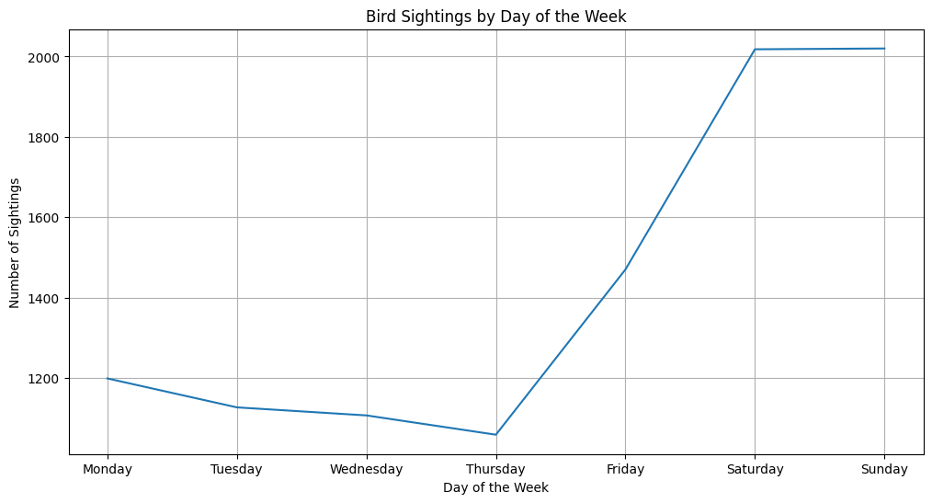
Notes:
As we might expect the sightings by day of the week are much higher at the weekends. The higher levels on Monday and Friday relative to mid-week may be because people tend to take “long weekends” as breaks.

Slide 7
Question 2 : Which areas of The Netherlands have more sightings and does the time of year have any significance (seasonality)?

Slide 8
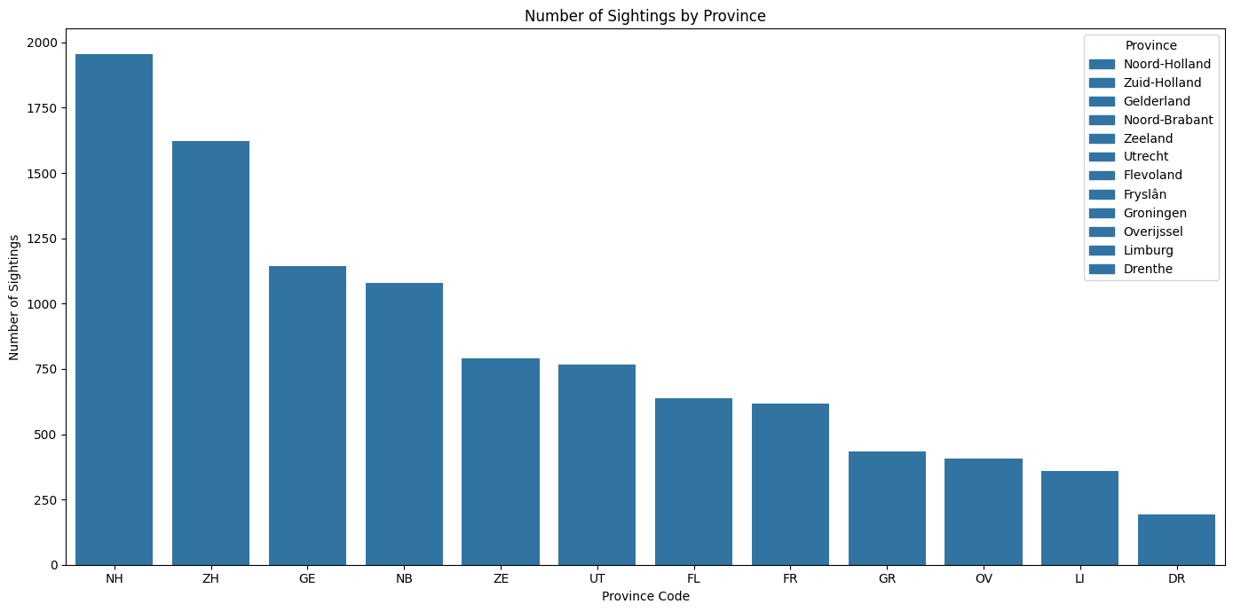
Notes:
There are twelve provinces in The Netherlands. Here we can visualise the number of sightings in each province.

Slide 9
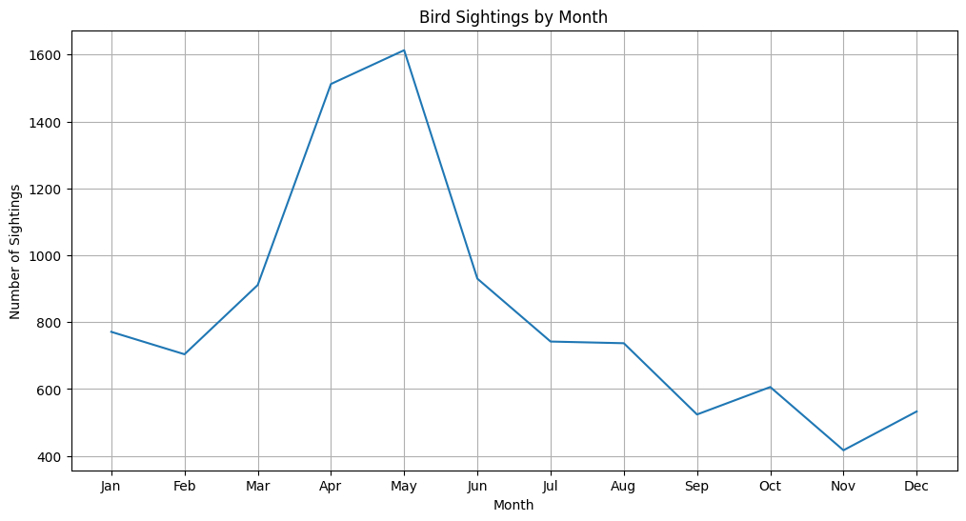
Notes:
We can see there is a large variation in the number sightings when categorised by month. The spring breeding season in spring logs significantly more sightings. I was a little surprised that the number of sightings during the summer months were as low given the extra duration of light during summer days.

Slide 10
Question 3 : Investigate the number of observations for the following types of the observation protocols (what the observer was doing): Stationary, Travelling, Historical and Incidental. What do we learn?

Slide 11
—Someone Famous
“This is a quote, words full of wisdom that someone important said and can make the reader get inspired.”

Slide 12
Observation Types
Traveling
Observations made over a known period of time while traveling a known distance are classified as a Traveling Count.
Stationary
Observations made over a known period of time, but without any distance/area components, are classified as a Stationary Count.
Historical
Birding was the primary purpose, but start time, duration, or distance could not be estimated. This protocol allows start time, duration, and distance to be entered, but none is required. Required Date/Effort fields: Date
Incidental
Observations do not include or distance/area components are classified as Incidental Sightings. Examples of an Incidental Sighting are: an oriole that flies by while you are checking your mail, a hummingbird feeding in your backyard while you wash dishes, a grouse just off the side of the road while you drive to work, or a flock of waxwings that move through your yard while you are weeding your garden.

Slide 13
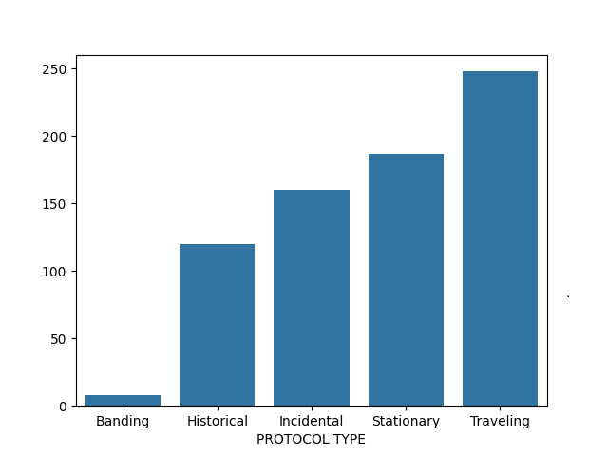
The slide title goes here!
Since there are so few observations while “banding” I only consider the other 4 categories for the investigation.
Do you know what helps you make your point clear?
Lists like this one:
They’re simple
You can organize your ideas clearly
You’ll never forget to buy milk!
And the most important thing: the audience won’t miss the point of your presentation

Slide 14
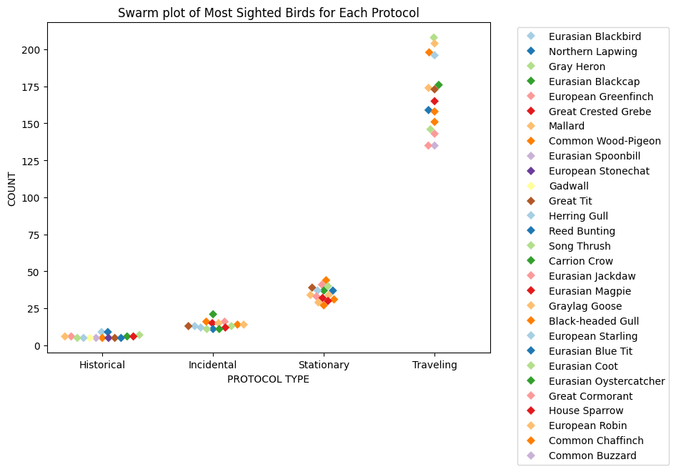
The slide title goes here!
Swarmplot of the most sighted birds for each protocol.
The bird types sighted by each protocol are largely consistent.
Do you know what helps you make your point clear?
Lists like this one:
They’re simple
You can organize your ideas clearly
You’ll never forget to buy milk!
And the most important thing: the audience won’t miss the point of your presentation
Notes:
This was originally going to be a barplot but since the information did not display clearly so I decided to change it to a swarmplot. We can s

Slide 15
Question 4 : Determine if there is a statistical dependency between birds observed and protocol type (the way they were observed). Which statistical test should we use?
Notes:
I wanted to test the statistical significance of the observations and protocol type. Since these values are categorical and nominal I decided on a Chi squared test.

Slide 16
Null Hypothesis (H0): The two categorical variables are independent.
Alternative Hypothesis (Ha): The two categorical variables are dependent.
Notes:
The Null Hypothesis in this case is that the 2 categorical variables are independent. The alternate would mean they are dependent

Slide 17
Chi Squared test result for all observations
Chi-squared Statistic: 1324.9197540938808
P-value: 7.970435261335829e-28 (Close to zero)
Degrees of Freedom: 807
The observed distribution of bird sightings is dependent on the protocol code.
Notes:
I ran the test two different times since there were many birds spotted only once and the Chi squared test works better with samples of 5 or larger. With the So, for the second iteration of the test I filtered by groups of 5 or more sightings and got a very high P value

Slide 18
Chi Squared test result for all observations > 5
Chi-squared Statistic: 193.2593629343629
P-value: 1.0
Degrees of Freedom: 447
The observed distribution of bird sightings is independent of the protocol code.
Notes:
I ran the test two different times since there were many birds spotted only once and the Chi squared test works better with samples of 5 or larger. With the So, for the second iteration of the test I filtered by groups of 5 or more sightings and got a very high P value. This could be due to the limited number of samples.

Slide 19
Question 5 : Determine if there is a statistical dependency between birds observed and protocol type (the way they were observed).
Notes:
I wanted to test the statistical significance of the observations and protocol type. Since these values are categorical and nominal I decided on a Chi squared test.

Slide 20
5. Is population in areas a significant predictor of no. of sightings?
Notes:
I wanted to test the statistical significance of the observations and protocol type. Since these values are categorical and nominal I decided on a Chi squared test.

Slide 21
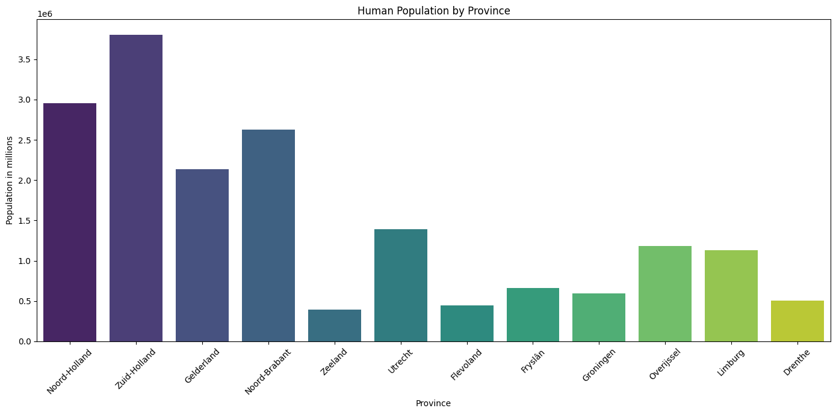
Population by province
Notes:
We can see North and South Holland provinces have the highest populations

Slide 22
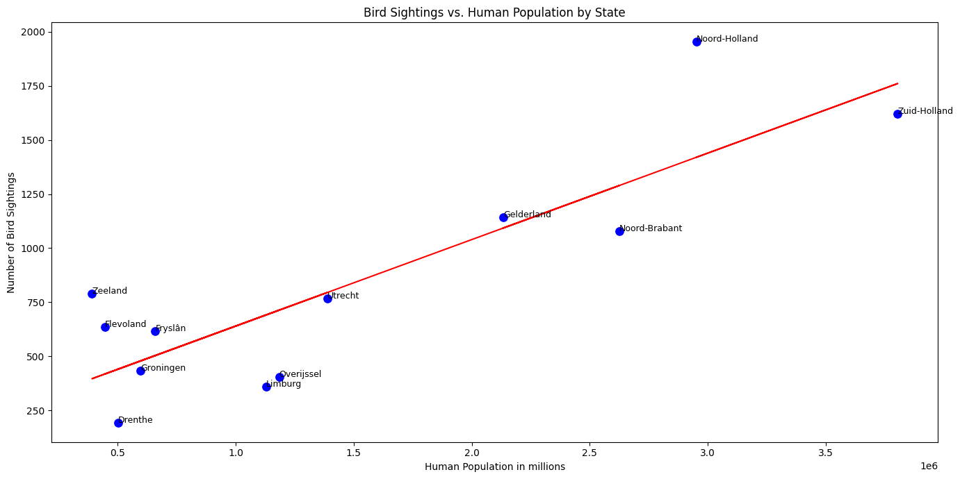
Results of OLS regression
Notes:
Even though south holland has a bigger population north holland has more observations. Perhaps this could warrant further investigation into why.

Slide 23
St
Mercury
Venus
Mercury is the closest planet to the Sun and the smallest one of them all—it’s only a bit larger than the Moon
Venus has a beautiful name and is the second planet from the Sun. It’s hot and has a poisonous atmosphere

Slide 24
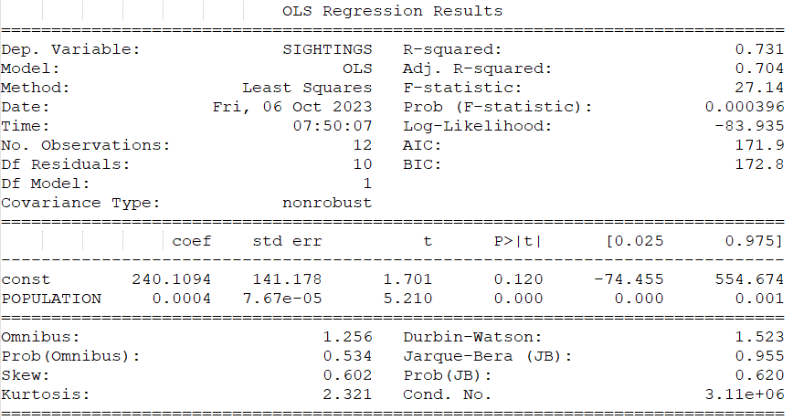
OLS statistical results
The model as a whole seems statistically significant and explains about 73.1% of the variability in sightings. Population is a significant predictor of sightings.
Notes:
The adjusted R-squared takes into account the number of predictors in the model. It adjusts for the increase in R-squared that comes with adding extra predictors. Here, the RSquared value of 0.704 means that after accounting for the number of predictors, about 70.4% of the variability in sightings can be explained. The Durbin Watson here, 1.523 suggests a slight positive autocorrelation, though not very strong. The Omnibus number is close to .5 which suggests residuals are normally distributed.

Slide 25
END

